Slide 1
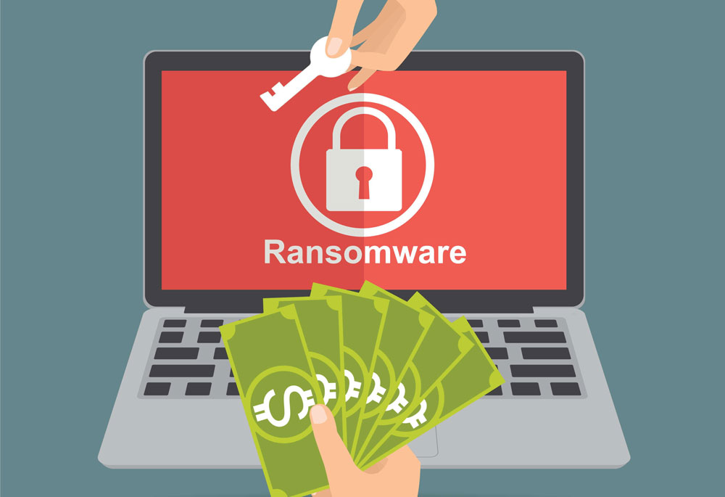
Presentation video tutorial of Ransomware
By : - EL HAOUAT Mohamed Amine
- SOUMARMONT Maxime
- GUIOT Thibault

Slide 2

1- Brainstorming
2- Why Ransomware?
3- Progress of the video
4- Necessary Materials
5- Reminder, why this video?
6- Conclusion

Slide 3
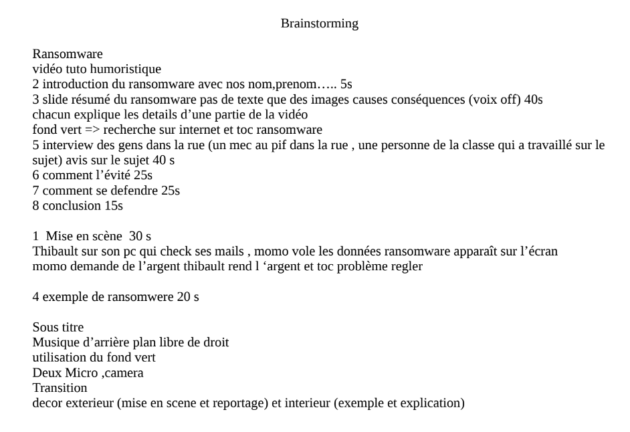

Brainstorming

Slide 4

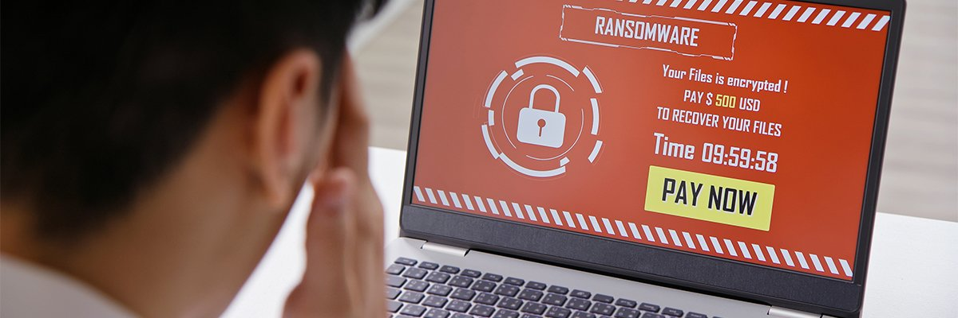
Why Ransomware?

Slide 5
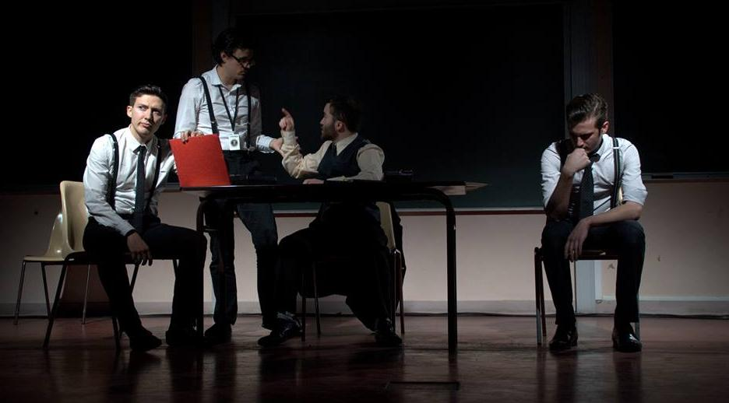
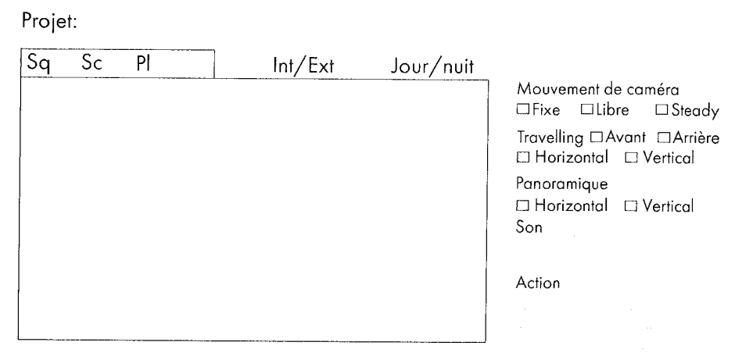

Progress of the video
Interviews with various people to find out if they know about ransomware
Thibault checking his emails, having his physical data stolen !
He has to pay to get them back

Slide 6

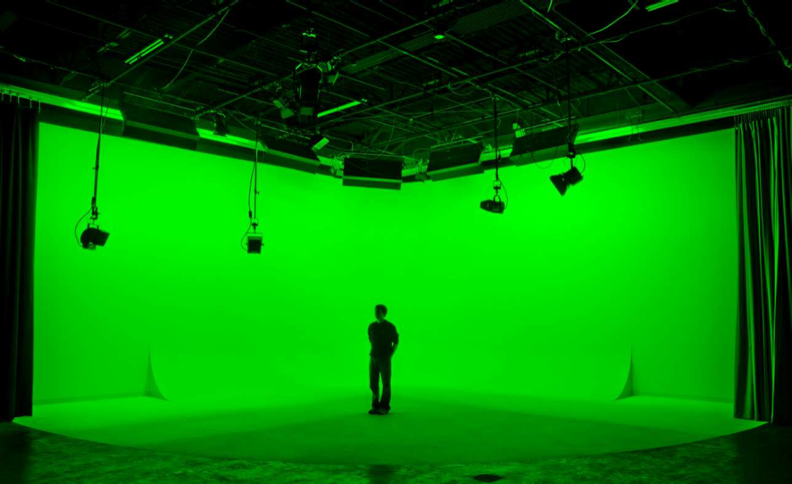


Necessary Materials

Slide 7


Reminder, why this video?

Slide 8


Conclusion

Slide 9


Thanks for your attention!
Do you have any questions ?

